Slide 1

Supporting CMIP6 Simulations with the ESMValTool
Lisa Bock, Björn Brötz, Veronika Eyring und Axel Lauer
Deutsches Zentrum für Luft- und Raumfahrt (DLR), Institut für Physik der Atmosphäre, Oberpfaffenhofen, Germany
1. Jahrestreffen CMIP6-DICAD
DKRZ Hamburg
11 October 2017

Slide 2
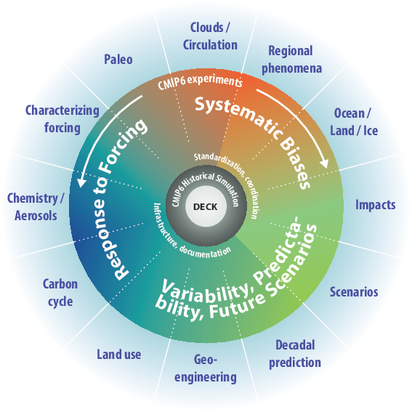
CMIP: a More Continuous and Distributed Organization
  (3) CMIP-Endorsed Model Intercomparison Projects (MIPs)
A handful of common experiments
    DECK (entry card for CMIP)
    AMIP simulation (~1979-2014)
    Pre-industrial control simulation
    1%/yr CO₂ increase
    Abrupt 4xCO₂ run
    CMIP6 Historical Simulation (entry card for CMIP6)
    Historical simulation using CMIP6 forcings (1850-2014)
Standardization, coordination, infrastructure, documentation
  DECK (Diagnosis, Evaluation, and Characterization of Klima) & CMIP6 Historical Simulation to be run for each model configuration used in CMIP6-Endorsed MIPs
Eyring et al., GMD, 2016

Slide 3

CMIP6: Participating Model Groups
 | Institution | Country |  | Institution | Country |  | Institution | Country
1 | AWI | Germany | 12 | DOE | USA | 23 | MRI | Japan
2 | BCC | China | 13 | EC-Earth-Cons | Europe | 24 | NASA-GISS | USA
3 | BNU | China | 14 | FGOALS | China | 25 | NCAR | USA
4 | CAMS | China | 15 | FIO-RONM | China | 26 | NCC | Norway
5 | CasESM | China | 16 | INM | Russia | 27 | NERC | UK
6 | CCCma | Canada | 17 | INPE | Brazil | 28 | NIMS-KMA | Republic of Korea
7 | CCCR-IITM | India | 18 | IPSL | France | 29 | NOAA-GFDL | USA
8 | CMCC | Italy | 19 | MESSY-Cons | Germany | 30 | NUIST | China
9 | CNRM | France | 20 | MIROC | Japan | 31 | TaiESM | Taiwan, China
10 | CSIR-CSIRO | South Africa | 21 | MOHC | UK | 32 | THU | China
11 | CSIRO-BOM | Australia | 22 | MPI-M | Germany | 33 | Seoul Nat.Uni | Republic of Korea
New in CMIP:
2 new model groups from Germany (AWI, MESSY-Consortium)
4 new model groups from China (CAMS, CasESM, NUIST, THU)
1 new model group from Brazil (INPE)
1 new model group from India (CCCR-IITM)
1 new model group from Taiwan, China (TaiESM)
1 new model group from USA (DOE)
2 new model group from Republic of Korea (NIMS-KMA, SAM0-UNICON)
1 new model group from South Africa / Australia (CSIR-CSIRO)
========================================
13 new model groups so far
* Other models can join providing DECK and historical simulations are submitted
More models (>70)
New models
More complex models
Higher resolution models

Slide 4
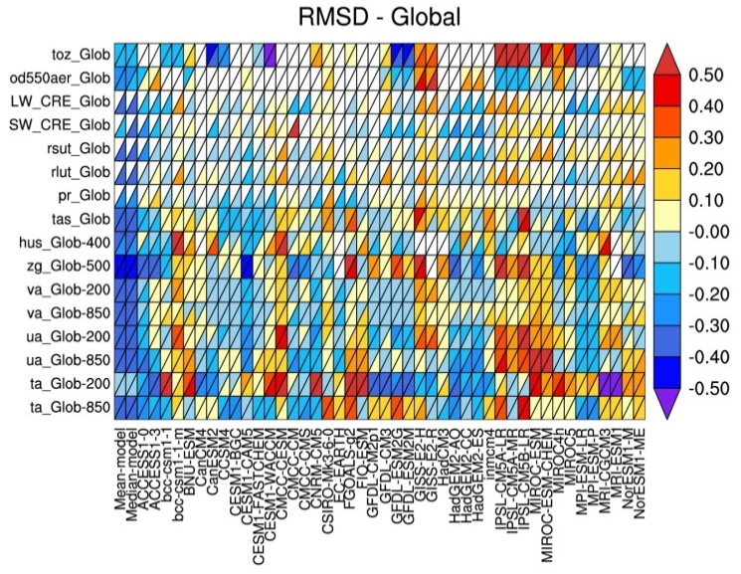
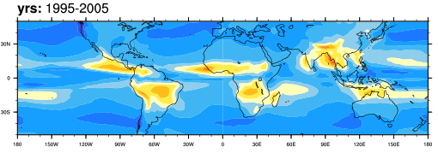
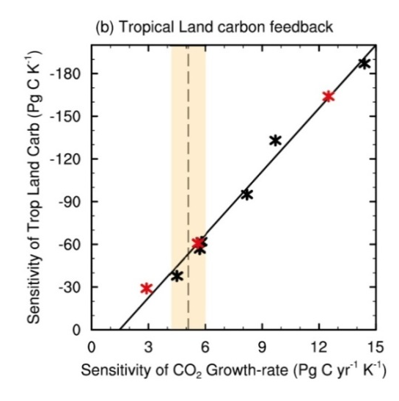
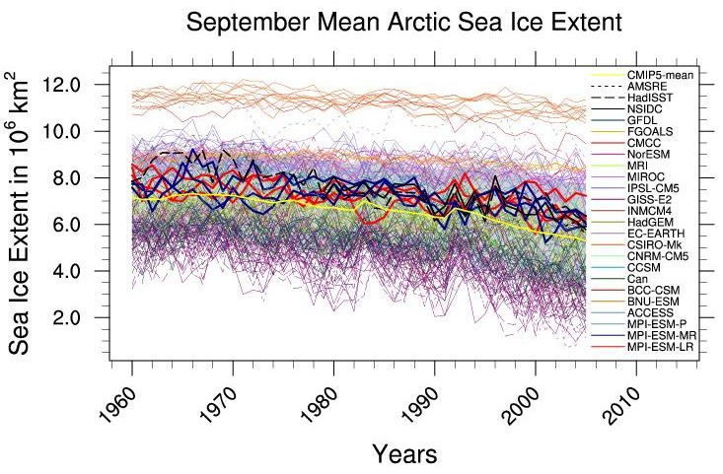
How to characterize the wide variety of models in CMIP6?
- Routine Benchmarking and Evaluation Central Part of CMIP6 -
Tools such as the community-developed Earth System Model Evaluation Tool (ESMValTool, Eyring et al., ESMValTool, GMD (2016b)) that includes other software packages such as the NCAR CVDP (Phillips et al., 2014)), and the PCMDI Metrics Package (PMP, Gleckler et al., EOS (2016)) to produce well-established analyses as soon as CMIP model output is submitted.
Similar to Figure 9.7 of AR5
Broad Characterization of Model Behavior
(incl. IPCC AR5 Chap 9 & 12 diagnostics in ESMValTool)
CMIP5 MMM
Monsoon Precipitation Intensity
CMIP5 MMM - OBS
Running alongside the ESGF
Similar to Figure 9.5 of AR5
Link to projections
Similar to Figure 9.24 of AR5
Net Cloud radiative effect against CERES EBAF
Similar to Figure 9.24 of AR5

Slide 5
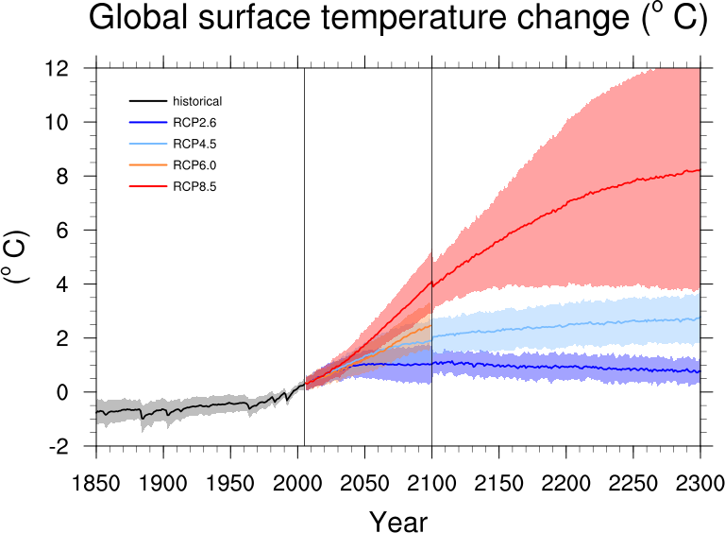
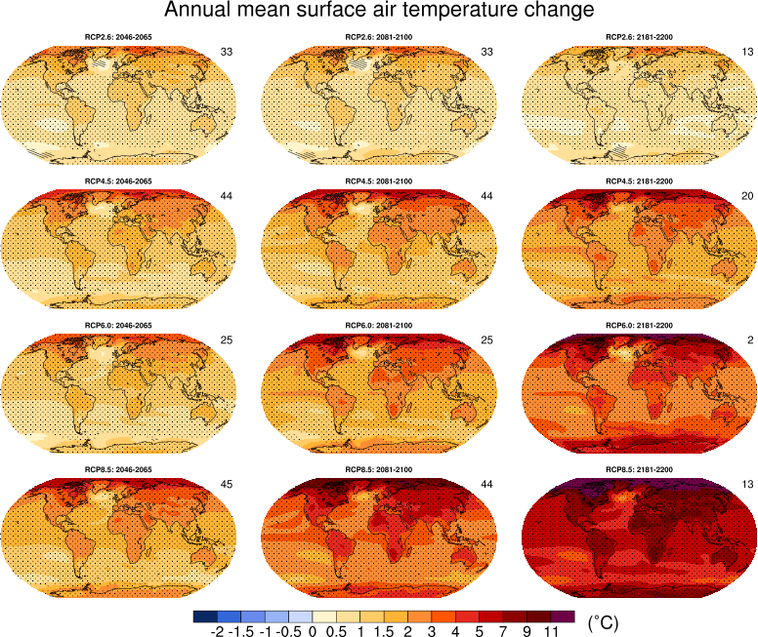
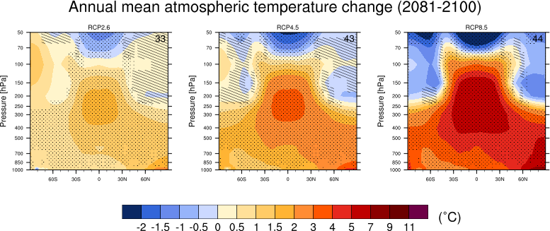
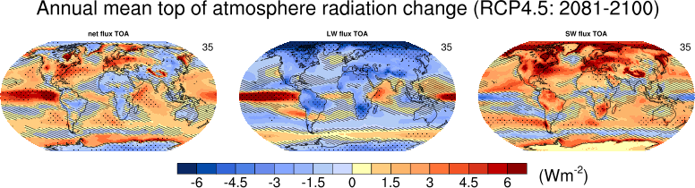
Example plots IPCC AR5 Chapter 12 in ESMValTool

Slide 6
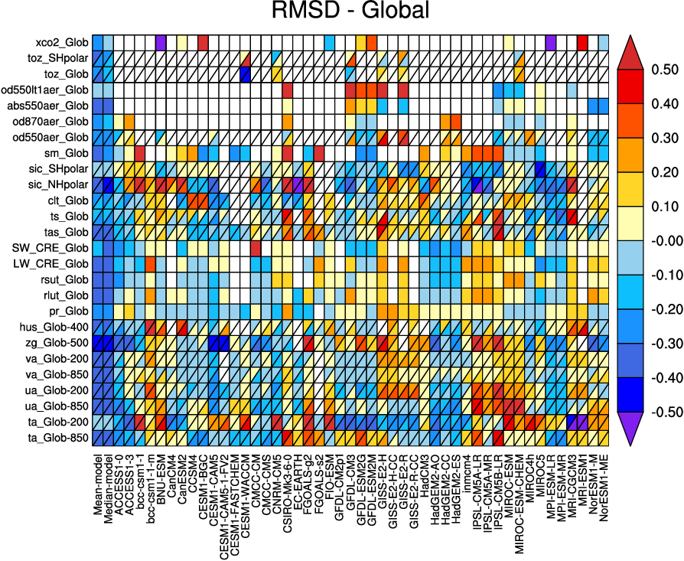
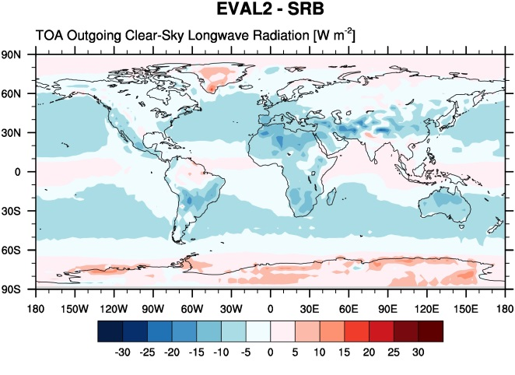
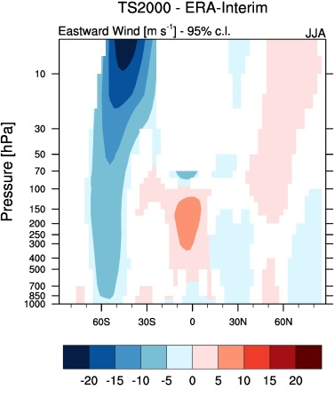
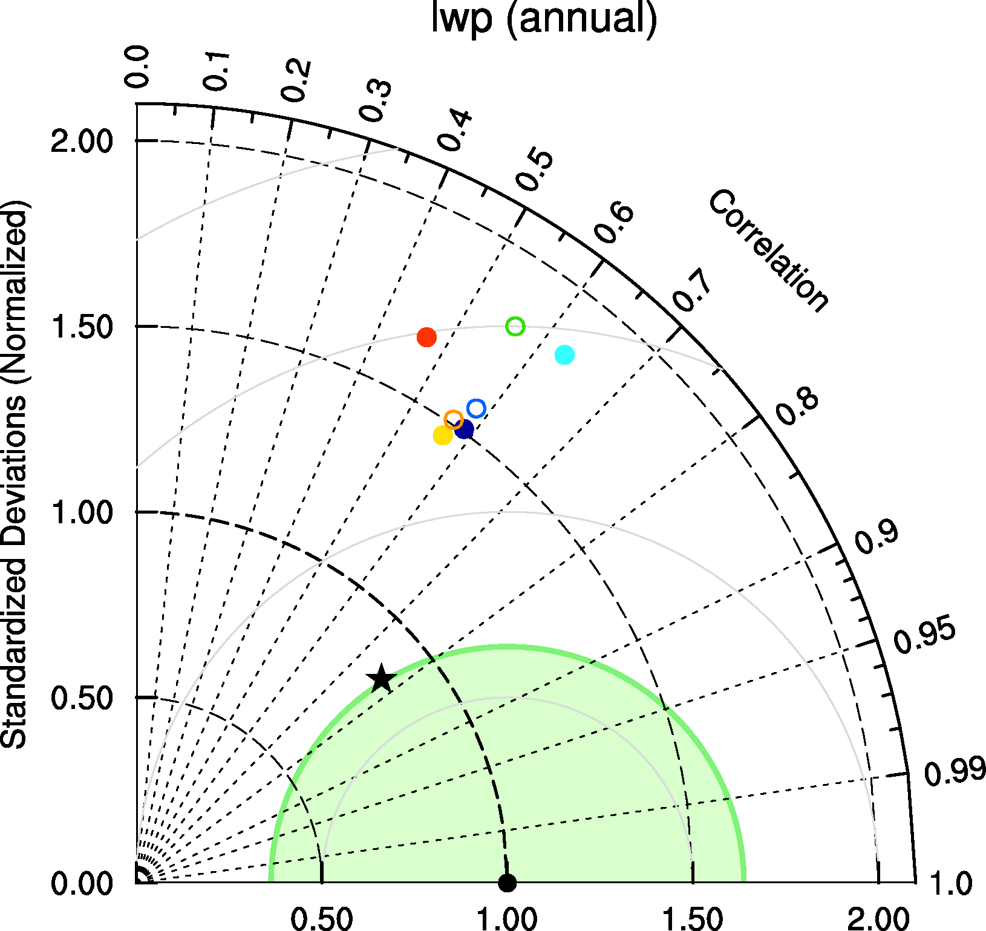
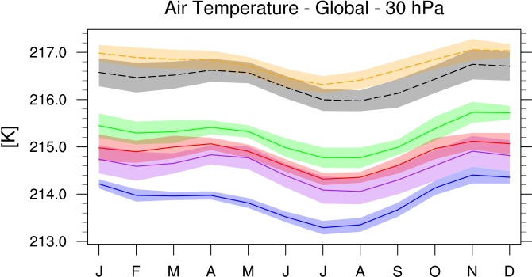
Diagnostics – Performance metrics

Slide 7
Examples for new diagnostics and metrics
CO₂ and CH₄ diagnostics
Emergent constraints (LTMI, southern ITCZ index, tropical mid-tropospheric asymmetry index)
Indices for extreme events
IPCC AR5 chapter 9
IPCC AR5 chapter 12
Land-atmosphere coupling
Land cover
Precipitation – soil moisture
Shifts in Austral jets
Snowfall
Soil moisture
Sea surface temperature

Slide 8
Examples of new observational datasets
Aerosols/chemistry/meteorology/land/ocean/sea ice
ACCESS-2 (conccnd5, conccnd10)
Asmill (aerosol size)
CFSR (psl)
CloudSat (clt)
ESA CCI AEROSOL (od550aer, abs550, od550lt1aer, od870aer)
ESA CCI CLOUD (clt, clwvi, clivi)
ESA CCI GHG (xco2, xch4)
ESA CCI OZONE (tro3, tropoz, toz)
ESA CCI SEAICE (sic)
​ESA CCI SOILMOISTURE (sm)
ESA CCI SST (ts)
ESRL (surface CO₂)
HadCRUT4 (tas)
HIPPO (mmrbc)
HWSD (soil carbon content)
ISCCP (albisccp, clisccp, cltisccp, cttisccp)
JMA-TRANSCOM (CO₂ exchange)
LAI3g (leaf area index)
MTE (gross primary productivity of carbon)
NDP (vegetation carbon content)
NIWA (toz)
TOMS (toz)
WHOI-OAFlux (hfls, hfss)

Slide 9
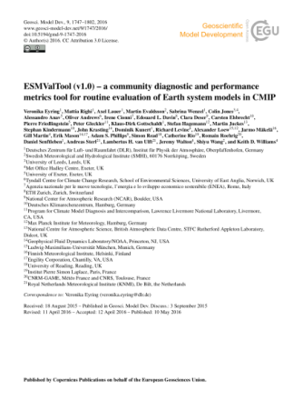
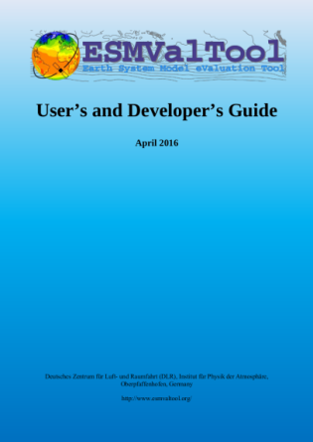
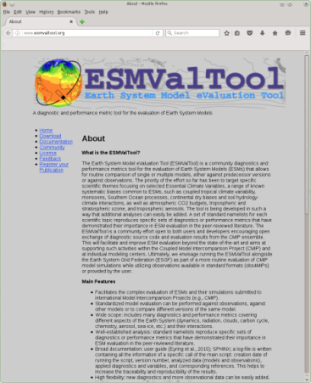
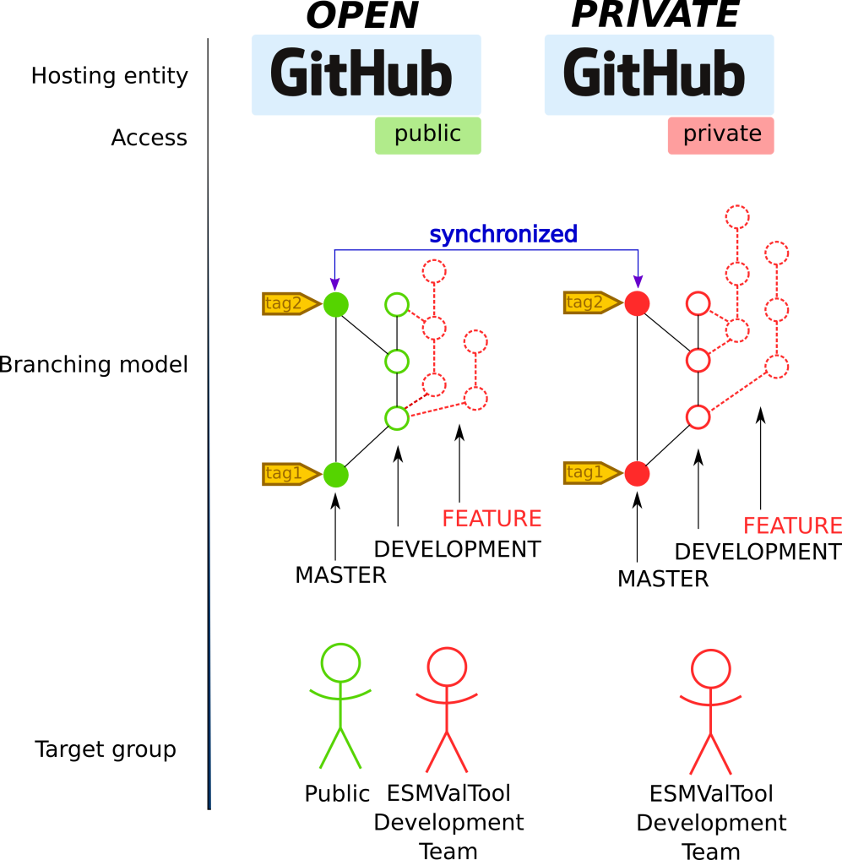
ESMValTool version 1.0 released as open source software
Community diagnostics and performance metrics tool for the evaluation of Earth System
Standardized model evaluation can be performed against observations, against other models or to compare different versions of the same model
Many diagnostics and performance metrics covering different aspects of the Earth System (dynamics, radiation, clouds, carbon cycle, chemistry, aerosol, sea-ice, etc.) and their interactions
Well-established analysis based on peer-reviewed literature
Ensuring traceability and provenance (e.g. input data, metadata, diagnostics (incl .citation), tool version, doi)
Currently ≈ 80 scientist from >30 institutions part of the development team and > 120 users
Development in several projects (e.g. APPLICATE, CRESCENDO, C3S-MAGIC, ESA CMUG, PRIMAVERA)
Rapidly expanding
http://www.esmvaltool.org/
Eyring et al., GMD, ESMValTool v1.0, 2016

Slide 10
Example for integration of the ESMValTool into the CMIP6 Workflow at the DKRZ*
Production phase
Data management phase
Routine evaluation
DKRZ
ESGF
Create compliance to CMIP conventions (CMORize, Metadata, etc.)
cmorized
routine
evaluation
Technical
quality control
ESGF remote
write simulation output timestep
publication
to ESGF
ESGF local
web visualization
Scientific quality control
AWI-CM
MPI-ESM
monitoring
EMAC
native
*Defined in the Project CMIP6-DICAD

Slide 11
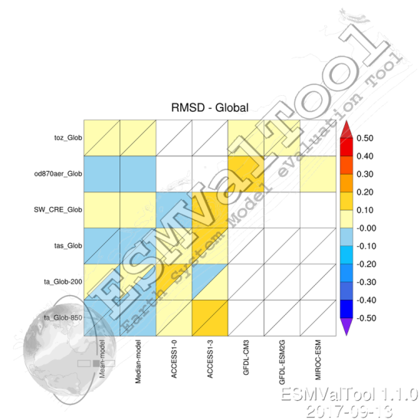
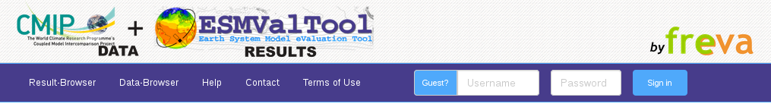
ESMValTool results provided with Meta-Data
models + observations
reformatting, calling diagnostics, plotting
caption
variables
statistics
domain
plot type
models/observations
input-files
namelist
diagnostic
project
theme
CMIP6 realms
contributing authors
software versions
ESMValTool
watermark
tags
(exif-header)
http://cmip-esmvaltool.dkrz.de/
.png
Visualization with FREVA (Cooperation with FUB)

Slide 12
Reproducibility & Provenance of evaluation results
Namelist
Evaluation analysis is controlled by the namelist file that defines the internal workflow for the desired analysis.
It defines:
Input datasets (observations, models)
Regridding operation (if needed)
Set of diagnostics
Misc. (output formats, output folder, etc…)
Logfile
At each execution of the tool a log file is automatically created
The log file contains:
The list of all input data which have been used (version, data source, etc.)
The list of variables that have been processed
The list of diagnostics that have been applied
The list of authors and contributors to the given diagnostic, together with the relevant references and projects
Software version of ESMValTool that was used
Output files (NetCDF, png)
Contain meta data from input files and meta data generated by ESMValTool
Observational data
Well defined processing chain
creation of metadata

Slide 13
ESMValTool Related Milestones in CMIP6-DICAD
- Standardisierte Diagnostiken und Modellevaluation (AP6) -
M1: Entwurf mit ausführlicher Spezifikation zum Portal [Monat 6, FUB]
M2: Prototype ESMValTool Version läuft in der ESGF DKRZ Infrastruktur [Monat 9, DKRZ]
M3: ESMValTool steht zur operationellen Laufüberwachung in der DKRZ Infrastruktur zur Verfügung [Monat 12, DLR]
M4: Lauffähiger und getesteter Prototype für das Portal [Monat 15, FUB]
M5: ESMValTool mit erweiterten Diagnostiken auf CMIP5 Modelldaten angewandt [Monat 18, DLR]
M6: ESMValTool mit CMIP6 Modelldaten und Beobachtungsdaten vollständig integriert in der ESGF DKRZ Infrastruktur [Monat 24, DKRZ]
M7: MPI-ESM1/2 und EMAC2 mit erweiterter ESMValTool Version evaluiert und mit anderen CMIP6 Modellen verglichen [Monat 36, DLR]
M8: Produktionssystem des Portals ist installiert [Monat 36, FUB]
AP 6.3 Milestone
AP 6.3 Milestone
=> Work in AP6.3 on time

