Slide 1
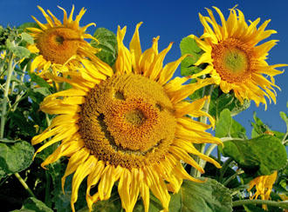
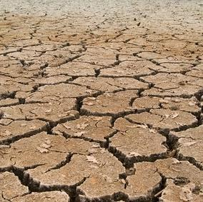
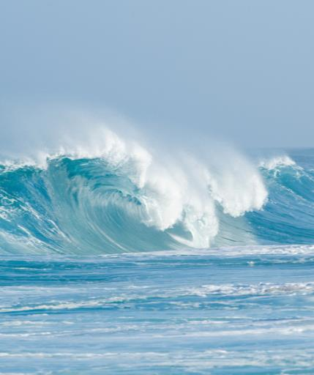

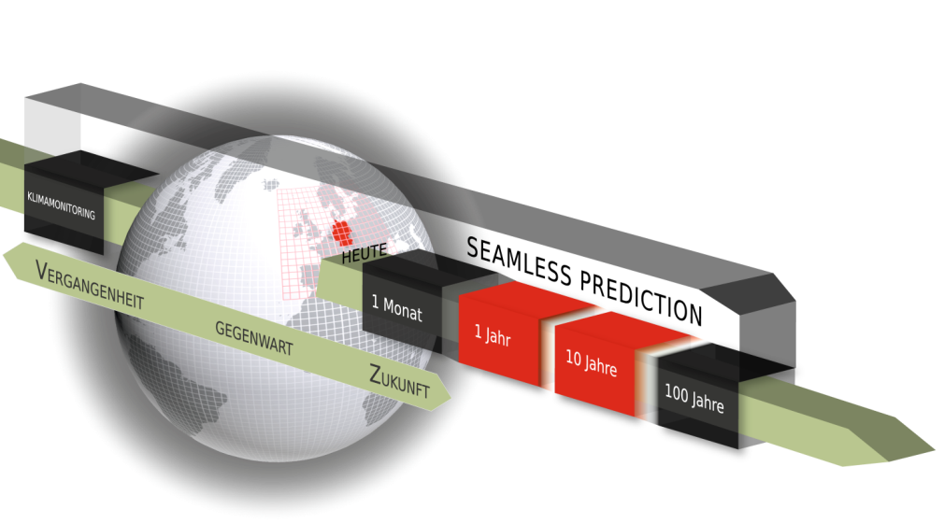
DWD Beitrag zu CMIP6-DICAD (TP3)
Dr. Barbara Früh
Deutscher Wetterdienst
Zentrales Klimabüro

Slide 2
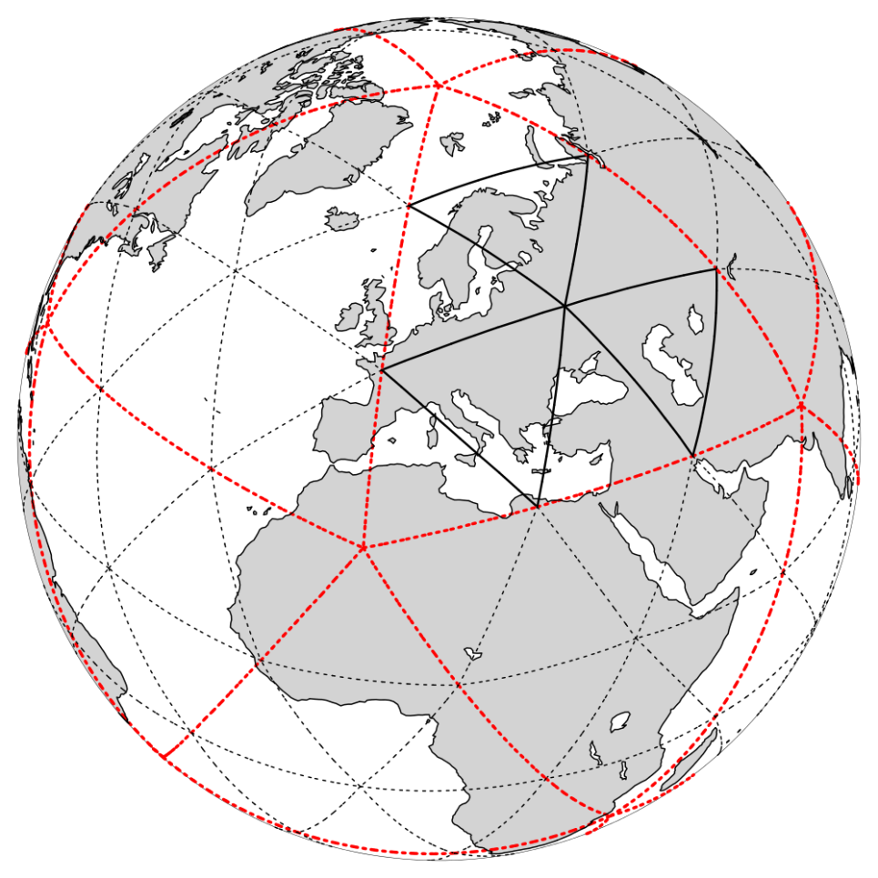
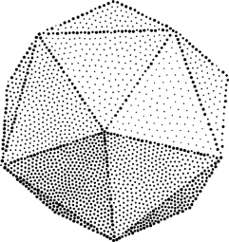
NWP @ DWD with ICON
ICON-EUcli AMIP experiments
Global:
Icosahedron projection onto a sphere
ICON (operational)
R3B07 (approx.13 km)
ICON grid construction:
division into n sections (Rn)
followed by k bisection steps (Bk),
→ resulting in a RnBk grid
Abbildung Quelle: DWD, Vortrag M. Köhler, 2015

Slide 3
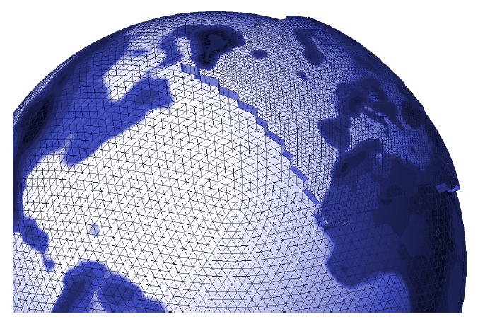
NWP @ DWD with ICON
ICON-EUcli AMIP experiments
ICON operational since 2014
ICON-EU operational since May 2016
Source: Reinert et al., ICON database reference manual, 21.07.2015

Slide 4
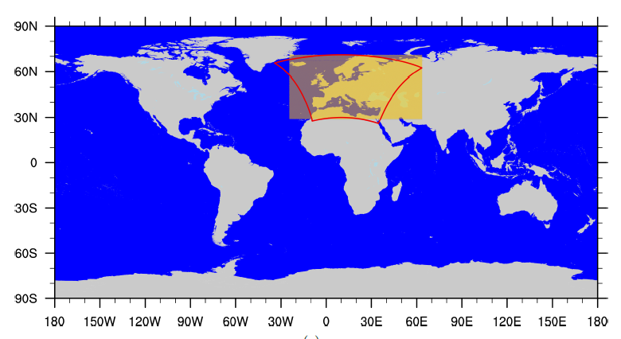
NWP @ DWD with ICON-EU
ICON-EUcli AMIP experiments
 | ICON-EU nest
geogr. coordinates | 23.5°W - 62.5°E 29.5°N – 70.5°N
mesh size | 6.5 km (R3B8) 659156 triangles
vertical levels | 60 levels
upper boundary | 22.5 km
ICON-EU similar to former COSMO-EU
Source: Reinert et al., ICON database reference manual, 21.07.2015

Slide 5
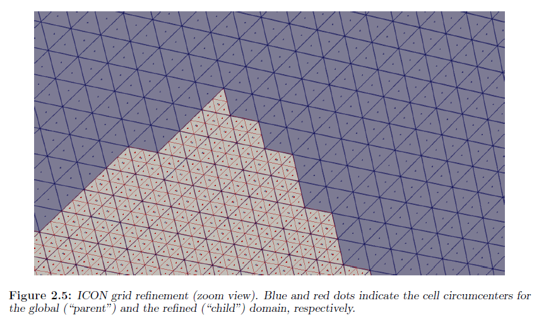
ICON-EU nest refinement
ICON-EUcli AMIP experiments
horizontal: triangular mesh of refined area is generated by bisection of triangles in the global parent’s grid
vertical: global grid extends into the mesosphere; nested domains only into the lower stratosphere
For each nesting level: time step automatically divided by factor 2
Source: Reinert et al., ICON database reference manual, 21.07.2015
Notes:
Extension into the mesosphere greatly facilitates the assimilation of satellite data
nested domains extend only into the lower stratosphere in order to save computing time

Slide 6
Idea for CMIP6–DICAD – TP3 (DWD contribution)
ICON-EUcli AMIP experiments
ICON climate AMIP
ICON-EU NWP
ICON-EUcli

Slide 7
CMIP6–DICAD – TP3 (DWD contribution)
ICON-EUcli AMIP experiments
familiarisation with ICON-EU in NWP mode and ICON in climate mode
implementation
model environment for climate simulations with ICON at DWD (workflow including pre- and post processing)
‚merging‘ ICON-EU in NWP mode with ICON in climate mode (ICON-EUcli)
integration of multiple nesting steps in ICON-EUcli to bridge the gap between the coarse global resolution and the high resolution in the inner most nest
cost-benefit analysis: multiple nesting steps vs. high global resolution, optimizing model configuration

Slide 8
CMIP6–DICAD – TP3 (DWD contribution)
ICON-EUcli AMIP experiments
Simulations
performing long term climate projections
Analysis
comparison of global ICON climate results with
  other ICON based simulations (MPI-M, PKNU, …)
  and other available CMIP6 AMIP-data
comparison of high resolution ICON-EUcli results with CORDEX data
reports, publications

Slide 9
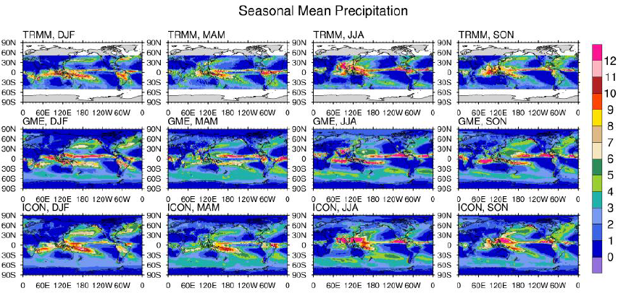
Pukyong National University, Busan, Korea
ICON-EUcli AMIP experiments
AMIP simulations for 1980-2007 years using ICON (R2B6 approx. 40 km)
Source: Oh et al., ICON at PKNU, 04.07.2016

Slide 10
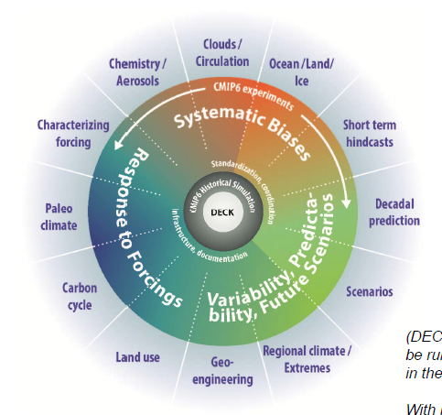


Supplementing MPI-ESM1 projections
CMIP6 climate projections
to be agreed
main interest:
  scenario runs
  usable for downscaling
  decadal predictions (MiKlip)
DECK
Folie: Eyring et al: Coupled Model Intercomparison Projekt Phase 6 (CMIP6): Design and Organization, 16 Jan 2015
(http://www.wcrp-climate.org/images/modelling/WGCM/CMIP/CMIP6FinalDesign_WGCMMeeting_150116_Sent.pdf v. 18.3.2015)
Notes:
CMIP Diagnostic, Evaluation and Characterization of Klima (DECK) experiments:

Slide 11
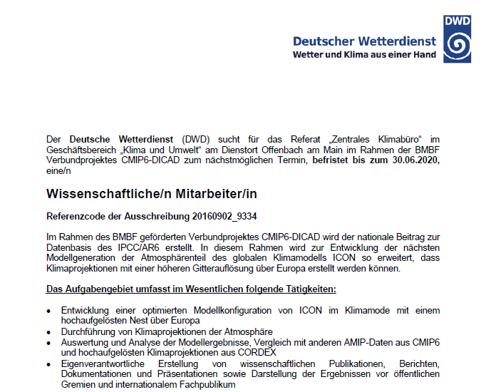
CMIP6-DICAP TP3
DWD contribution
ICON-Eucli AMIP experiments:
Granted:1 PostDoc, 4 years
Job announcement open until June 28, 2016
Employment starts approx. January 2017
6 months delay!!!
Supplementing MPI-ESM1 projections
DWD staff starting January 2017
Notes:
CMIP Diagnostic, Evaluation and Characterization of Klima (DECK) experiments:

Slide 12
Vielen Dank für Ihre Aufmerksamkeit
Dr. Barbara Früh
Deutscher Wetterdienst – Zentrales Klimabüro
Barbara.Frueh@dwd.de

