Slide 1
CMIP6 / ENES Data TF Meeting: DKRZ
DKRZ RM-ODP Views
Status Developments:
CMIP6 PID Integration
CMIP6+ Data Ingest
QA
Collection of open issues
Notes:
Large Scale Data Project meet RDA 5th Plenary Session
RDA adoption benefits from perspective of a national service provider, embedded into a set of international climate data management e-infrastructure projects
DKRZ → broader context (ESGF, EUDAT, IS-ENES, WDCs)

Slide 2
DKRZ RM-ODP views
Enterprise view
purpose, scope, policy, .. → strategic view
Computational view
Functional decomposition (objects, interfaces,..) → application designer view
Engineering view
Communication and resource control
Information view
Technology view
Notes:
Overview of DKRZ: some info, history, compute and storage facilities, stakeholders
WDCC and international climate data management infrastructures: IS-ENES, ESGF, EUDAT, ..
RDA adoption plans at DKRZ:
Early pid assignment (data ingest time) in life cylce
Back-linking of (late coarse granular) data citation to individual data entities

Slide 3
DKRZ computational viewpoint
DKRZ HPC Cluster
Visuali-
sation
Service Nodes
VM cluster (XEN)
Interactive Nodes
Data
Nodes
(Test)
WDCC
Data
Node
ESGF Data
Nodes
DTNs
Index
Nodes
(Test)
Index
Node
Processing
Nodes
Project VMs
PID VMs
WDCC
Portal
Fuse
(Batch)
Compute Nodes
WDCC FUSE
Oracle
DB
NFS
Lustre
I/O
NFS
WDCC / CERA
LTA
Lustre
File System
WDCC / CERA
Cache
National CMIP Pool
HPSS
Tape Backend
DKRZ openstack cloud
WDCC / CERA
Long Term Archive Data

Slide 4
DKRZ enterprise viewpoint (data centric)
stakeholder
MPI-M
Uni HH
Resource usage (storage / compute)
Helmholtz
Association
AWI
„system funders“
Geesthacht
Data and compute resources
DKRZ sys admin group
BMBF (current and prior systems – not next generations)
Data Production
Data Postprocessing
„Modelers“
Data
Analysis
Data Ingest / Replication
„Climate data Researchers“
Data Management
External data managers, data federations, ..
DKRZ data managers
Data
Distribution
„Climate data federations“
DKRZ data sys admins
QA + Long Term
Archival
Data service development / depoyment / operation
National Initiatives / Projects / ..
(CMIP6, Reklies,...)
International Initiatives / Projects / ..
(ESGF, EUDAT, ENVRI+,..)

Slide 5
CMIP6 PID integration requirements
PID registry /
Handle server
CMIP6: single handle prefix
→ Central PID registry
handle v8 REST API
Need to cope with CMIP6 load (millions of registrations, parallel bursts from multiple clients)
→ Highly scalable PID registration process
!?
Minimal impact on standard esgf publication process
→ Non blocking, asynchronous handle registration necessary
ESGF data nodes
ESGF
publisher
Esgf-PID client
Easy installation as part of ESGF data node
→ ESGF PID client package as part of ESGF publisher

Slide 6
CMIP6 PID integration
PID registry /
Handle server
Hosted at DKRZ
Tests: ~ 130 PID reg. requests per second on VM (5 Mio requ.)
Optimization potential with physical machine + SSD: > 1000 requ. per second reported by CNRI
handle v8 rest interface
pyhandle client
ESGF PID consumer
Rabbit
exchange
Highly scalable, persistent message queuing infrastructure
Guaranteed delivery of ESGF PID reg. requests
Fail-over endpoints for ESGF PID client
DKRZ exchange
Hosted at DKRZ + one other ENES partner (IPSL ?)
RZG exchange
Rabbitmq message
interface (amqp)
ESGF
pyhandle client
esgf-pid client
ESGF PID curation tools
ESGF data nodes
ESGF
publisher
esgf-pid client
ESGF PID part of CMIP6 publisher (PyPi package)
Configuration via CMIP6 ini

Slide 7
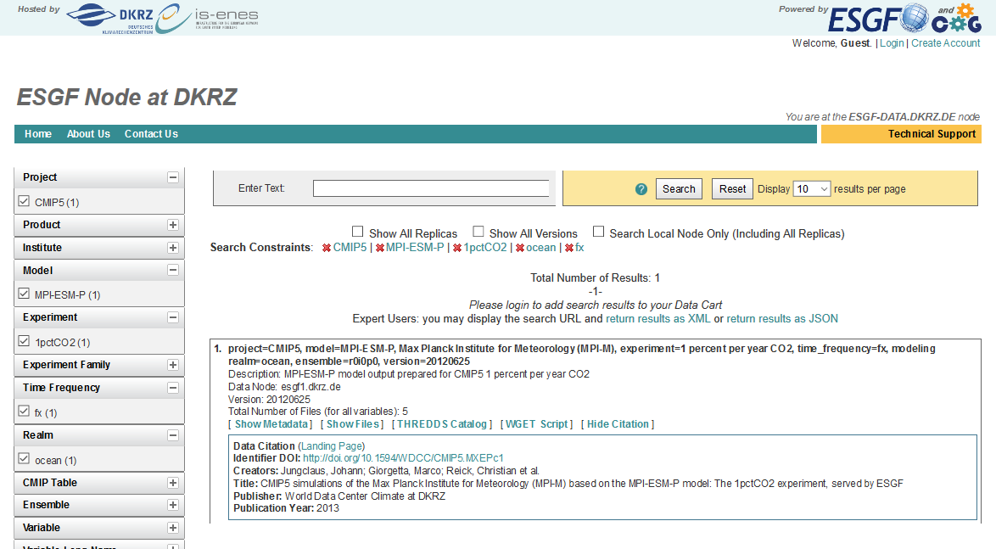
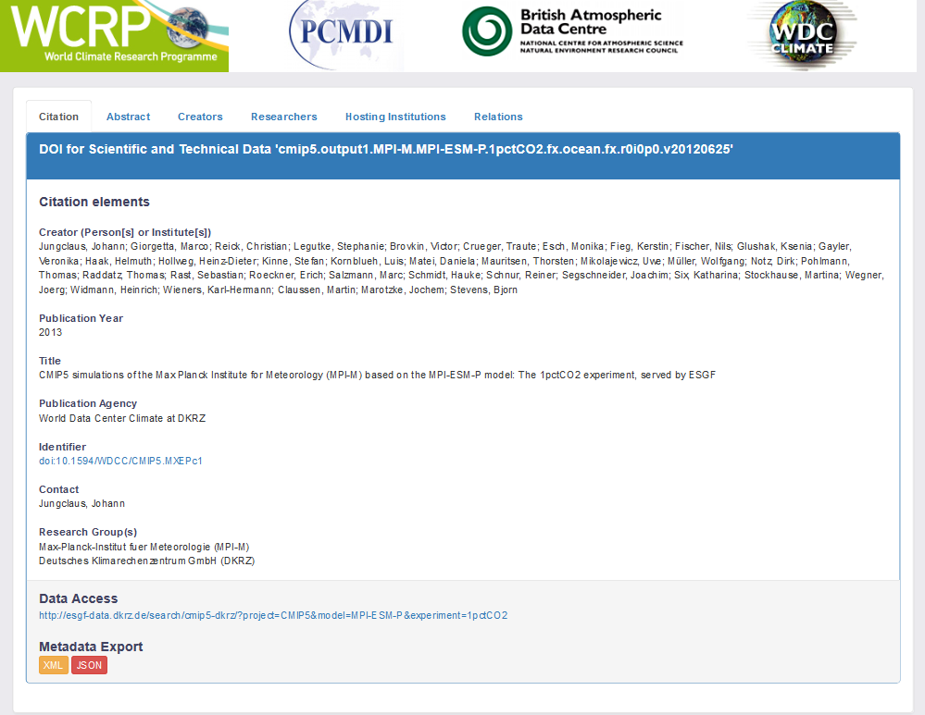
CMIP6 citation info + DOI landing page
CMIP5 example: http://esgf-data.dkrz.de/search/esgf-dkrz/?project=CMIP5&model=MPI-ESM-P&experiment=1pctCO2&time_frequency=fx&realm=ocean

Slide 8
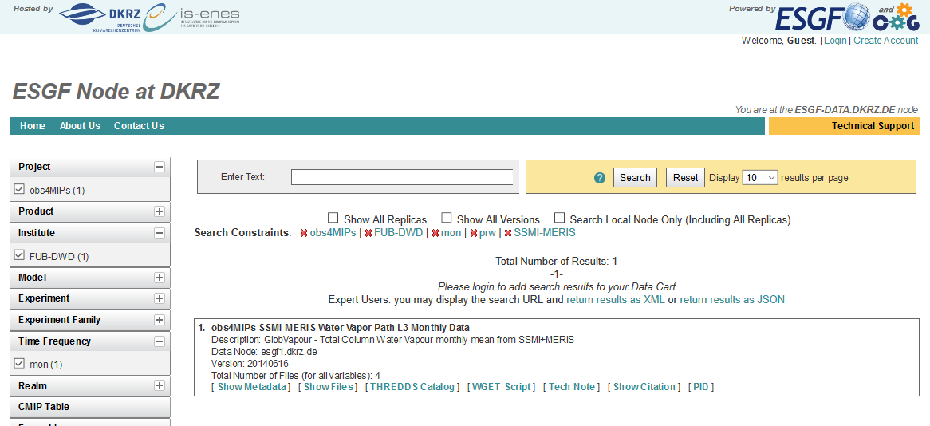
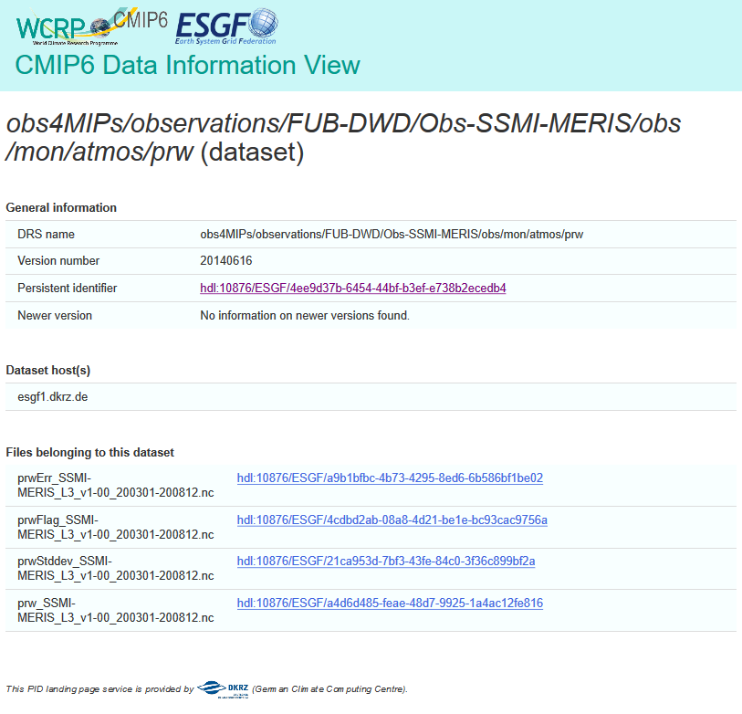
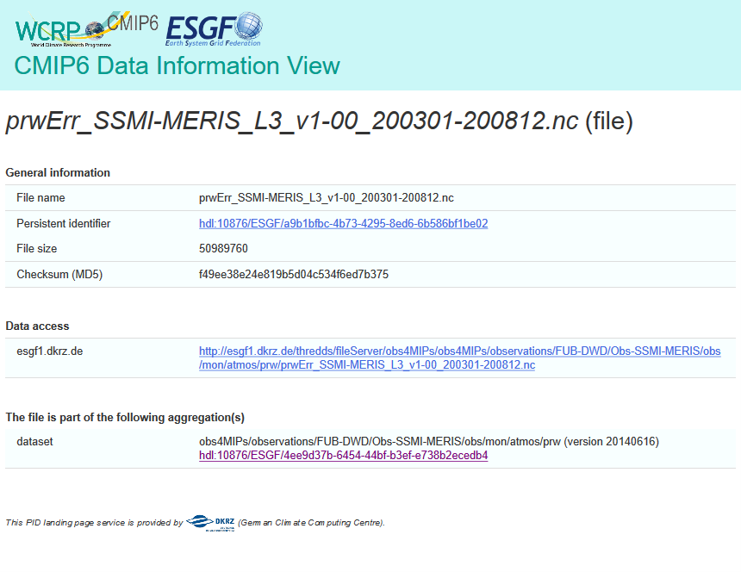
CMIP6 PID landing page
Obs4Mips example: http://esgf-data.dkrz.de/search/esgf-dkrz/?project=obs4MIPs&institute=FUB-DWD&source_id=SSMI-MERIS&variable=prw&time_frequency=mon
landing page service at DKRZ
CMIP6 prototype based on django python web framework

Slide 9
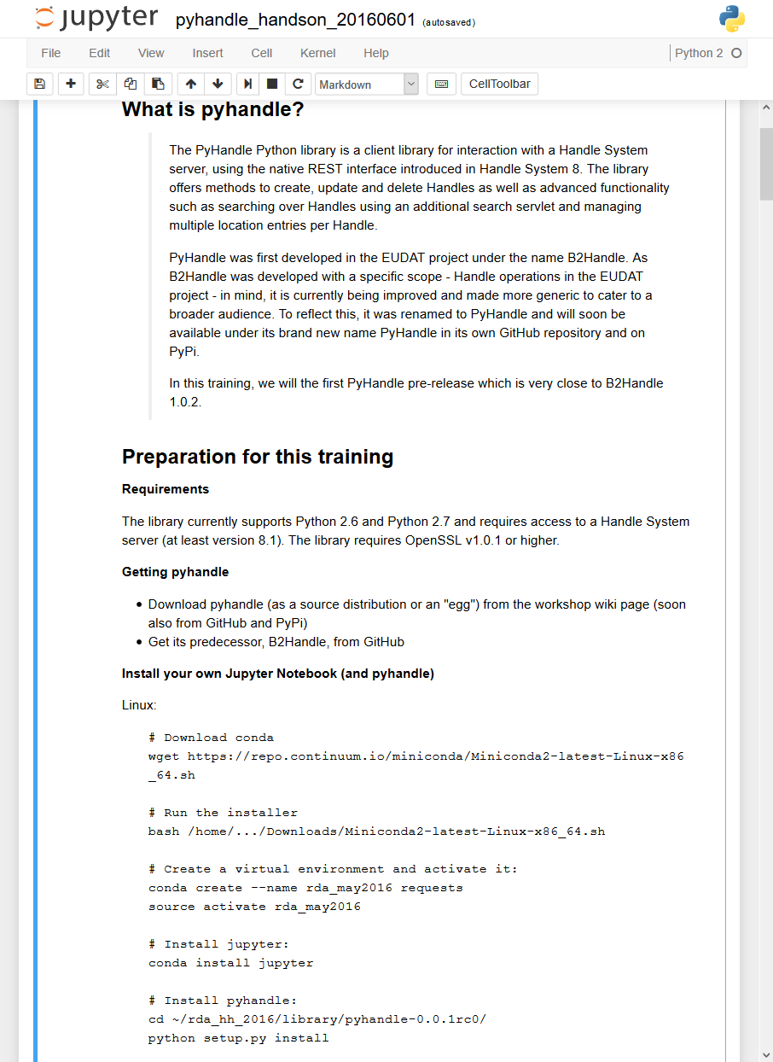
PID system clients
pyhandle client: python client to interact with handle system v8 API
Generalization of b2handle client (https://github.com/EUDAT-B2SAFE/B2HANDLE)
EUDAT collaboration – used in RDA PID Trainingsworkshop at DKRZ May 2016
esgf-pid-client python client to asychronously interact with the esgf-pid message queuing system (rabbitmq)

Slide 10
DKRZ data ingest and national CMIP6+ data pool
Tickting
System
Data provider
Submission form
---
---
Form validation
CMIP6+
Data pool
Data ingest / removal
json
repo /db
Data quality assurance
CMIP6+ Data pool ingest requestor
Data publication / registration
Request
form
---
---
Data archival
Status:
Core system in place (repo, form system, different APIs)
Next: stepwise integrate in operational workflow – parallel development of missing integration pieces
Complete data ingest provenance available for data in CMIP6+ data pool
→ (W3C PROV representation)

Slide 11
Open Issues Collection
IS-ENES User Support for CMIP6 (general + scientific)
CDNOT related:
CA signing also in USA, ..?
Update and Organization of COG project pages
CMIP5,CORDEX ☹ -- do better for CMIP6 !? How ?
Data ingest for IS-ENES how to ?
By now site specific intransparent procedures ..
Who publishes to whom, who takes data from whom, .. Who replicates what ..
To be filled .. ☺

