Slide 1
Provenance (for Earth science data)
DKRZ-Seminar, Oct 15 2012

Slide 2
Agenda
What is provenance? Why do we care?
Alternative Provenance definitions
Gathering and representing provenance information
Further resources

Slide 3
What is provenance?
And what does it mean in our context?

Slide 4
Provenance: Definition
For data produced by computer systems:
„The provenance of a piece of data is the process that led to that piece of data.“ (Moreau 2010)
This is a generic base definition.
Other terms: data lineage, history
(provenance also applies to food ingredients, works of art, ...)

Slide 5
Our context…
What is our context?
digital-born ESM output data
observational data, e.g. remote sensing imagery
various processed derivates
What are its characteristics?
complex, non-standardized toolchain
various processing steps by various actors
no single infrastructure
Notes:
This talk focuses on data provenance. There is of course provenance for other things relevant in our context, for example software code. The view will not change much for these, however it is easier for now to concentrate on data as our ‚common currency‘.

Slide 6
Use Cases (1)
Quality of scientific data
The processing history of a data object forms an important part of its scientific context.
Users who did not create a data product must be able to understand the implications that went into its creation.
Data may be reused many years after creation.
Notes:
Why should we care about provenance information?
Re-use of data may be much more the case for observational data than for model output data.

Slide 7
Use Cases (2)
Reproducibility
If processing steps are recorded in detail, a future user may reproduce them to get the exact same results
May be impossible for ESM output data in all its depth
We can‘t archive the supercomputer itself
Yet, try to capture as much as possible

Slide 8
Use Cases (3)
Attribution
Give credit to the original data producer
Citing a DataCite DOI may not be enough
Who is using data that is generated with DKRZ‘s resources?
Provenance can enable anyone to trace back to the original source and producer
Notes:
Citing a DataCite DOI is not enough because the processing history of the data is not directly linked to the DOI.
Tracing back to the original source is important for various actors, e.g. reviewers, but also data consumers looking at data several years (decades) after its creation.

Slide 9
Data-intensive science
The scenarios grow more important with data-intensive science
Data is shared across scientific communities
Focus shifts from data production to data analysis
The Fourth Paradigm (2009)

Slide 10
Provenance and the data life cycle
Provenance may cover the whole data life cycle
Here: focus on earlier parts
data generation
data processing

Slide 11
Alternative provenance definitions
There‘s more than one!

Slide 12
The task
The task here: Develop an understanding of provenance that is specific and pragmatic in our context.

Slide 13
Provenance definitions
Why-Provenance
Where-Provenance
Provenance as a process
Provenance as a Directed Acyclic Graph
(there are more…)
Database context
Moreau (2010)
Notes:
Why-, Where- and How-provenance are the earlier research topics and the origins of the research field. Provenance as a process is probably the most widely accepted definition. Provenance as a DAG is a (in my opinion) nice, adequately small, expressively limited concept with a low entry barrier.

Slide 14
Why-Provenance
Context of database queries
Why-Provenance: „tuples whose presence justifies a query result“
„Why is X part of the result?“
„Because the queried input data contains tuple A“
Moreau (2010), Buneman et al. (2001)

Slide 15
Where-Provenance
A Website displays a typo in a menu entry
What is the database field this string comes from?
This may not be the database directly connected to the website, but e.g. a citation database maintained elsewhere and queried by the site
Helps to illuminate the copying of information across databases.
Moreau (2010), Buneman et al. (2001)

Slide 16
Provenance as a process (1)
The computation that resulted in the data
Any
data
event
user action
that can be connected to the data through a computational process potentially belongs to its provenance
Moreau (2010)
Notes:
The information potentially relevant can be very broad. What we may want to capture based on the DAG view is just a subset.

Slide 17
Provenance as a process (2)
ESM execution: The context can get very vast.
model source code
all parameters, model conditions, forcings
user name, libraries, OS version, parallel architecture
...
Moreau (2010)

Slide 18
Provenance as a DAG
What is a Directed Acyclic Graph?
... What is a graph?

Slide 19
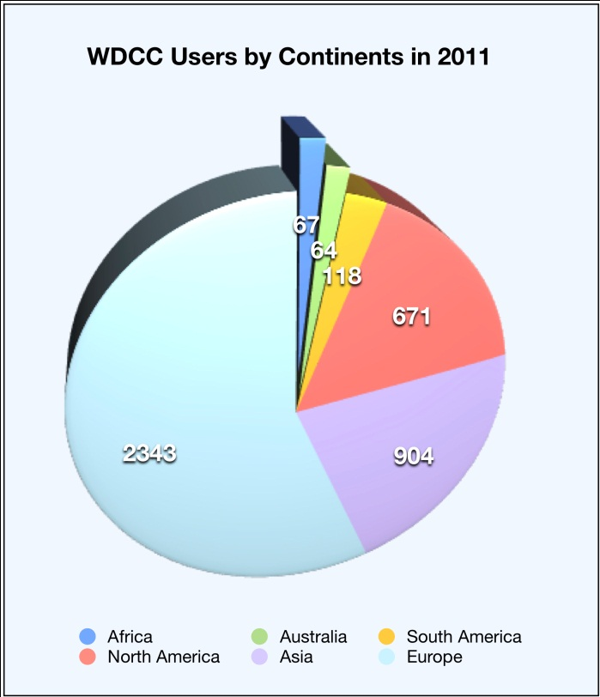
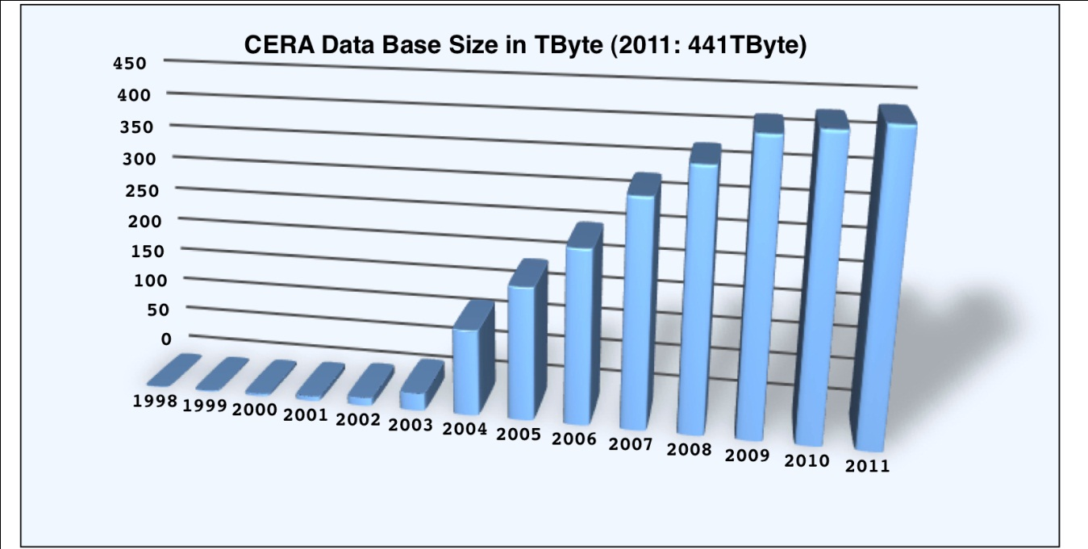
What is not a graph?
These are no (mathematical) graphs.

Slide 20
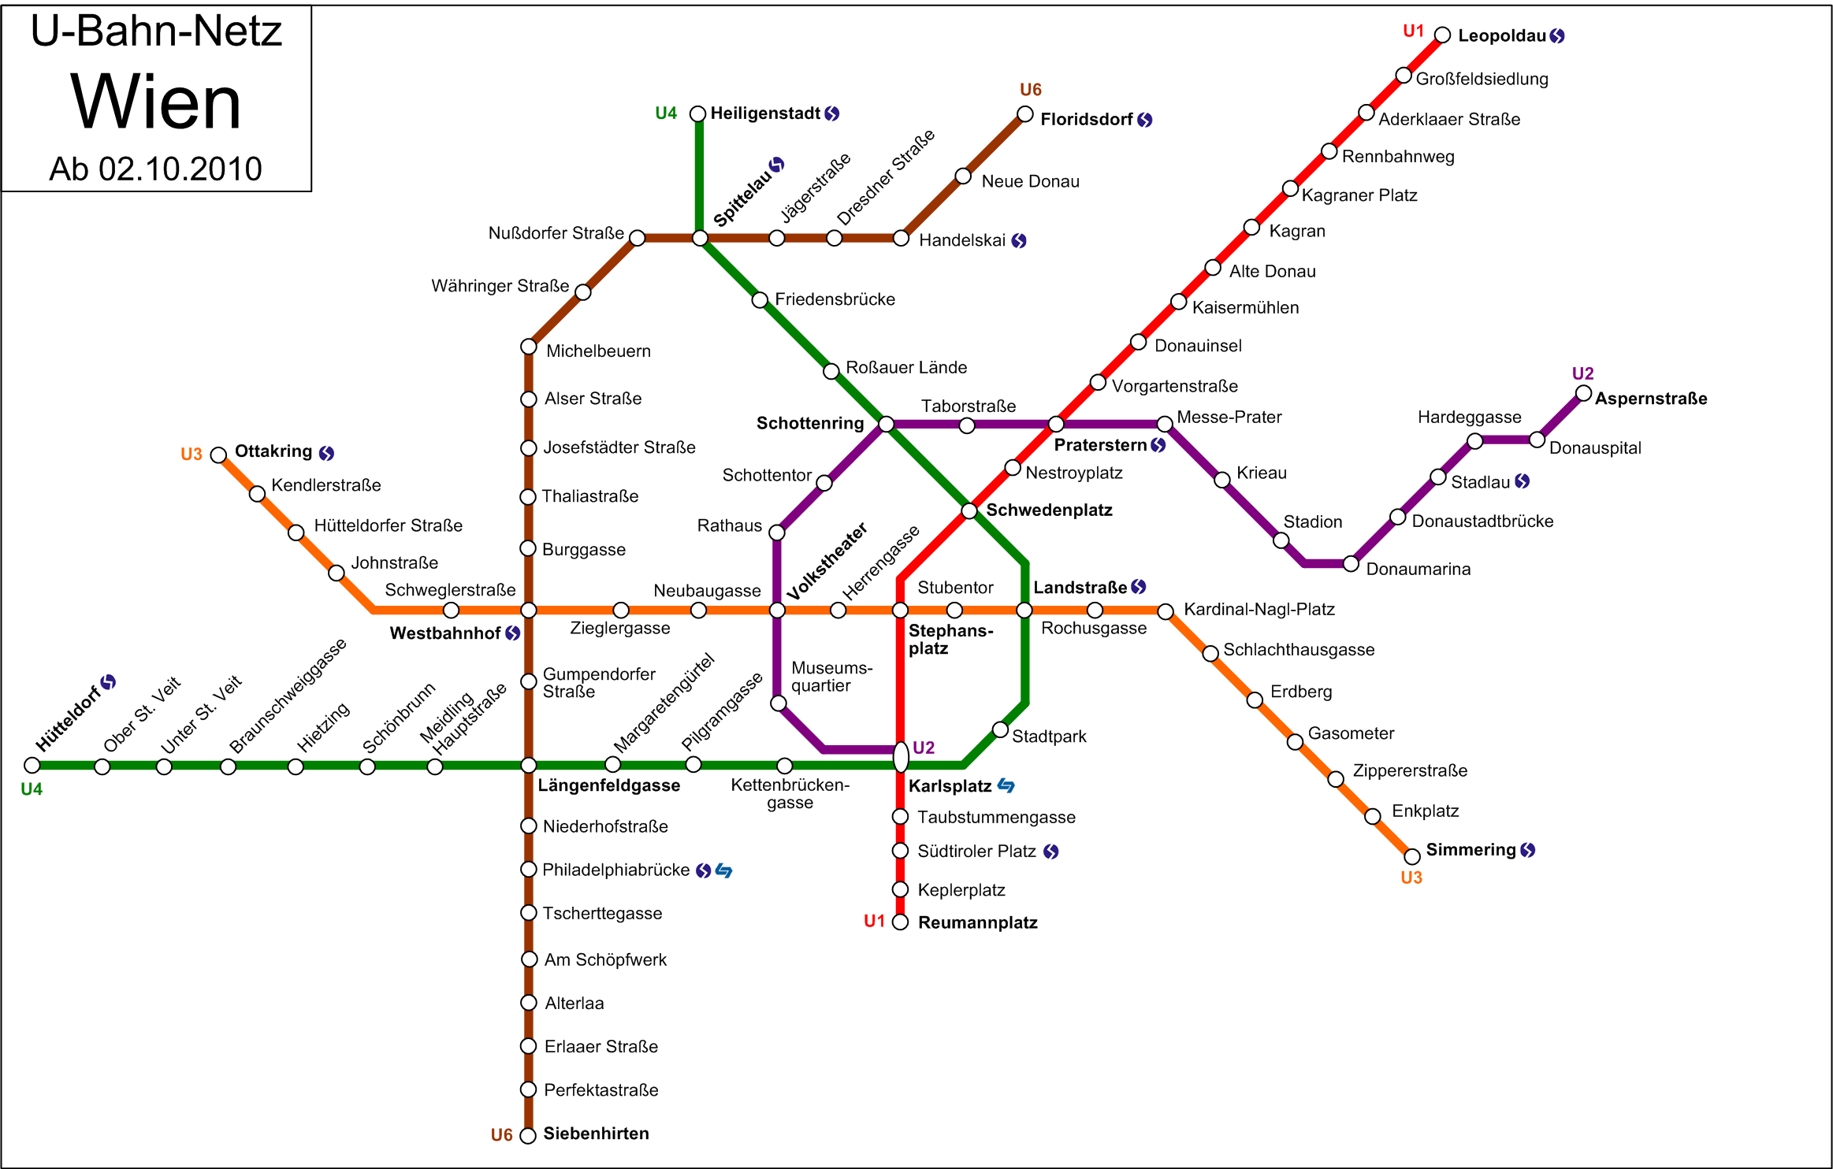
What is a graph?
This is a graph. Graphs are everywhere.
Wikipedia

Slide 21
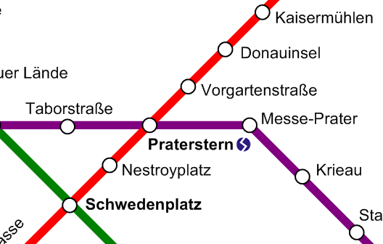
What is a graph?
Graph theory: A graph consists of a set of nodes (vertices) and a set of edges
G = (V, E)
any e ∈ E is an unordered set (v₁, v₂); v₁, v₂ ∈ V

Slide 22
What is a directed graph?
Directed graph
directed edges
set (v₁, v₂) is ordered; the edge is directed from v₁ to v₂

Slide 23
What is a Directed Acyclic Graph?
Directed Acyclic Graph (DAG)
directed edges
no cycles allowed!

Slide 24
Provenance as a Directed Acyclic Graph
Simplified, data-centric view
Nodes represent data items
Edges represent derivative operations
„predecessor“, „successor“, „derived-from“, ...
uni- or bidirectional
Level of detail depends on the use cases
t
cdo
Moreau (2010)

Slide 25
Provenance information is part of the metadata
Provenance information is part of the metadata
Curating this metadata is tedious and pragmatically impossible
It is agreed that provenance gathering must be automated
View a provenance record as something created on the fly, rather than a stored document
provenance is the result of a query over process assertions (Moreau 2010)

Slide 26
Applications
What is out there to gather, represent, exploit provenance?

Slide 27
Gathering provenance information
Many tools exist to capture provenance through an embracing system (particularly workflow systems)
Lots of research and academic prototypes
A list is available at http://www.openprovenance.org
Provenance information may be aggregated in a specific database (provenance store)
Notes:
From my feeling, the elaborate approaches don‘t fit well with out research environment, thus the idea of breaking it down to small pieces and enahancing our existing tools.

Slide 28
Gathering provenance: workflow systems
Scientific workflow systems
e.g. Taverna, Kepler, VisTrails, ...
Advantages
Potentially good coverage
Improves collaboration and knowledge transfer
Disadvantages
all or nothing
high migration costs
do not match user‘s traditional workflow
Notes:
All or nothing: either a user uses a workbench or she doesn‘t. There is no middle ground – e.g. using a workbench just for some tasks and sticking to the command line and traditional tools for others is highly inefficient and will not be accepted by the users.

Slide 29
Gathering provenance information - alternative
For us: no overarching system possible in the mid-term
Alternative idea: capture proveance in small pieces by enhancing the existing tools of the research environments

Slide 30
Gathering provenance: in small steps
Advantages
results scale well with implementation effort
potentially small change to user workflow
Disadvantages
fragmentary coverage
incoherent, potentially chaotic information
mandates strict standardization

Slide 31
Representation of provenance information
Provenance information can be represented in many formats
human-interpretable: human-adressed log files, free text
machine-interpretable: traversable graphs
simple (A derived from B)
complex (semantic graph, Open Provenance Model)

Slide 32
Machine-interpretable representation required?
Machine-interpretable representation of provenance: what is the desired level of detail?
more detail → more sophisticated representation language required
So the core question is: does your use case require sophisticated machine-interpretable representation?
remember: machine-interpretability is for tools, not for humans

Slide 33
Representation formats
Machine-interpretable representation of gathered information
Designed to span across systems
Standardized representation formats
2010: Open Provenance Model (OPM)
2012: W3C PROV (Draft status)
The same set of people are involved

Slide 34
OPM: Agents, Processes and Artifacts
OPM and W3C are both graph-based representations
In the following: The Open Provenance Model (OPM) in brief

Slide 35
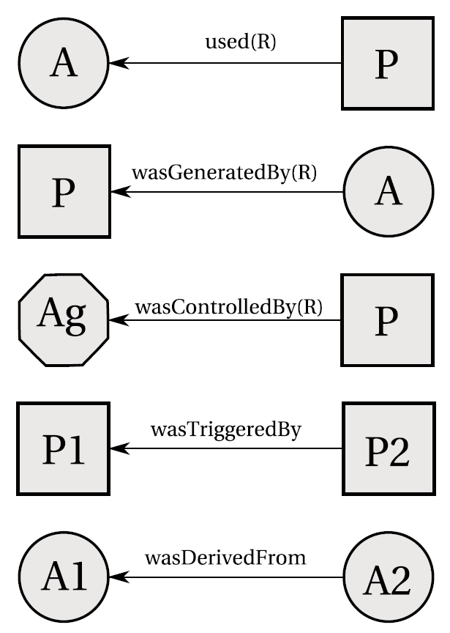
Open Provenance Model: base elements
Agents
cdo, user
Processes
calculate monthly means
Artefacts / Entities
input and output data, log file
These are modelled in the past.
Moreau et al. (2010b)
Notes:
An artefact is an immutable piece of state. An entity is the W3C PROV equivalent.
An agent can be a user, but also a software agent, i.e. running code – like cdo.
A process is a computational activity, resulting in new artefacts.
Precise definitions can be found in the OPM specification.

Slide 36
Motivations for W3C PROV
W3C PROV continues the work of OPM
Roughly: align it to RDF/OWL and other Semantic Web standards

Slide 37
Querying and viewing provenance
Exploit encoded provenance information?
visualization
querying
Notes:
I haven‘t looked in detail into this, but there is no „killer app“ out there.

Slide 38
Summary: what is provenance?
To summarize this particular view:
Provenance is the result of a query over process assertions.
Such assertions can in their simplest form be represented through an (ever growing) DAG.
Including more details requires a process view that embraces a larger context.
Provenance information is subject to LTA
Notes:
LTA, long-term archival

Slide 39
Bottom-up approach
Suggestion: Start small and simple.
Collect small pieces of information
automatically, infrastructure task, do not burden data producer
Provide tools to gather intelligence from this heap of information
DAG-view has obvious simple querying model (tree) and is easy to understand and explain
Build the DAG as a base layer, then attach richer context to the nodes or edges

Slide 40
And then some...
Construct a provenance graph using Persistent Identifiers?
PhD topic
DKRZ-Seminar on Persistent Identifiers
Wednesday, 17 Oct
14-16h
Same place (R34)

Slide 41
Further reading
Luc Moreau: The Foundations for Provenance on the Web (2010)
main influence is Web science
summarizes the research field very well
includes an extensive bibliography
OPM specification: http://www.openprovenance.org
W3C PROV: http://www.w3.org/TR/prov-primer/
Notes:
Moreau 2010 is a very good first read. The OPM is more approachable than the W3C Prov. The W3C Prov is already very rich in technical detail, which may be too much for first steps.

Slide 42
The End.
Thank you for your attention.

Slide 43
References
Moreau (2010): The Foundations for Provenance on the Web, doi:10.1561/1800000010
pre-print: http://eprints.soton.ac.uk/268176/
Moreau et al. (2010b): The Open Provenance Model Core Specification (v1.1), doi:10.1016/j.future.2010.07.005
The Fourth Paradigm, 2009, Microsoft Research
Buneman et al. (2001): Why and Where: A characterization of Data Provenance, doi:10.1007/3-540-44503-X_20

